Slide 1
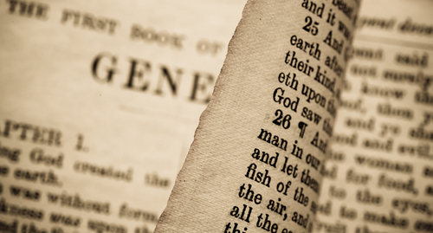
In The Beginning:
THE FAMILY
Genesis 1:26 – 2:25
part 2

Slide 2
Man Marries And Gives In Marriage
The Consent of Jesus:
6 "But from the beginning of the creation, God ‘made them male and female.’
7 ‘For this reason a man shall leave his father and mother and be joined to his wife,
8 ‘and the two shall become one flesh’; so then they are no longer two, but one flesh.
9 "Therefore what God has joined together, let not man separate."
Mark 10:6-9

Slide 3
The Want of Woman
Made in the image of God (Gen. 1:27)
Only after the creation of woman was it “very good” (Gen. 1:31)
  Genesis 2:18, “And the LORD God said, ‘It is not good that man should be alone; I will make him a helper comparable to him.’”

Slide 4
CAN
WHAT
WE
LEARN FROM THIS?

Slide 5
Man and woman are connected historically
  Genesis 2:21-24
Woman needs man
  Genesis 2:22; 1 Corinthians 11:8
Man needs woman
  Genesis 2:20; 1 Corinthians 11:9, 11, 12
Woman is the helper for man
  Genesis 2:18, 20
Marriage is between “one” man and “one” woman
  Mark 10:8; Matthew 19:5; Ephesians 5:23, 31

Slide 6
Marriage is the training ground for children
  Malachi 2:15
Marriage is the training ground for parents
  Ephesians 5:33; 1 Pet. 3:1-7; 1 Timothy 3:4, 5; etc.
God hates divorce (putting away)
  Malachi 2:16; Mark 10:9
Fornication is a violation of the marriage bond and the only permitted reason to divorce (put away) and remarry
  Matthew 19:9; 5:32

Slide 7
Matthew 19:9
“And I say unto you, Whosoever shall put away his wife, except it be for fornication, and shall marry another, committeth adultery: and whoso marrieth her which is put away doth commit adultery” (Matt. 19:9, KJV)
Not sinful to put away for the reason of fornication and remarry
SIN

Slide 8
Summary
Because we are made in the image of God, we are accountable moral agents
Because we are not animals, we marry
Marriage is an intellectual, emotional, moral, and honorable place that exists only for man to enter
Subduing the earth was never independent from the act of marriage
Marriage was the only authorized way for man to fill the earth
Since God created marriage, man should enter it reverently

